Slide 1
INFO8096-23F-SEC3 BIG DATA ANALYTICS
For Non-Executives
By Group 2,
Adegbite, Abidemi
Bhatt, Aesha
Chavda, Harshrajsinh
Upender, Sanjana
Waramwar, Shivdas Balajirao
Wu, Reece
Final Project

Slide 2
Introduction
Dimensional Model
Classification Model
QnA
Text Model
Summary
Table
of Contents

Slide 3

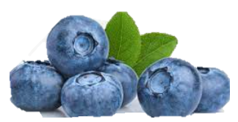
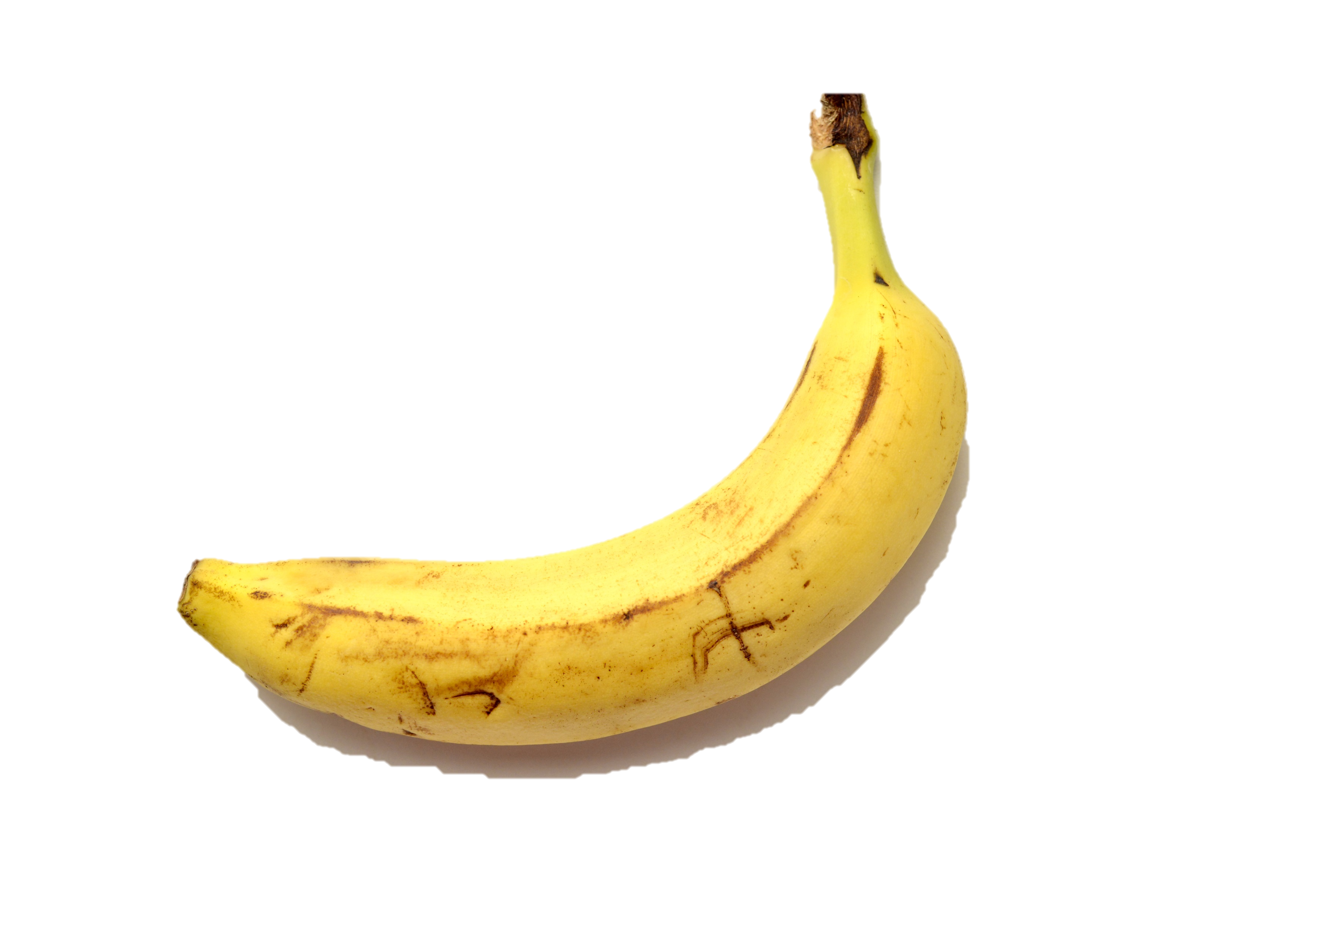
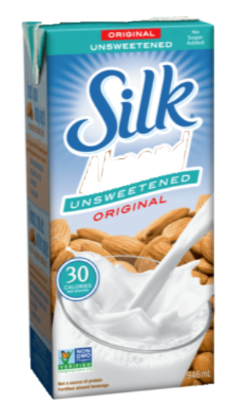
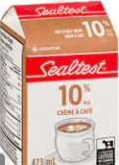
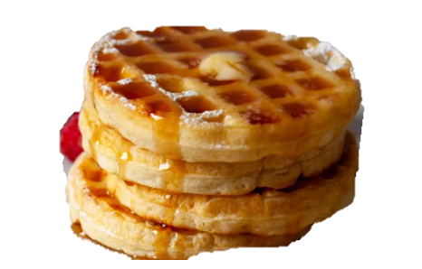
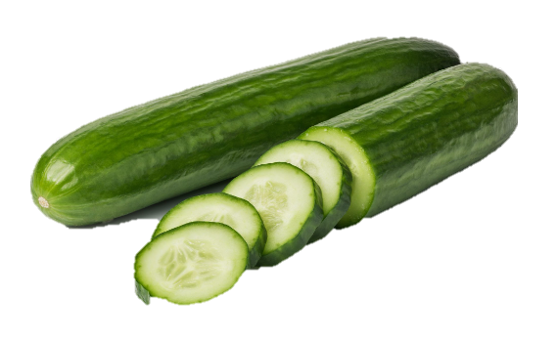
Analyzed 100 Sales Transactions
from Jan’22 to Nov’23
Project summary
On Groceries
We have performed modelling on this data. Insights on the next slides….

Slide 4
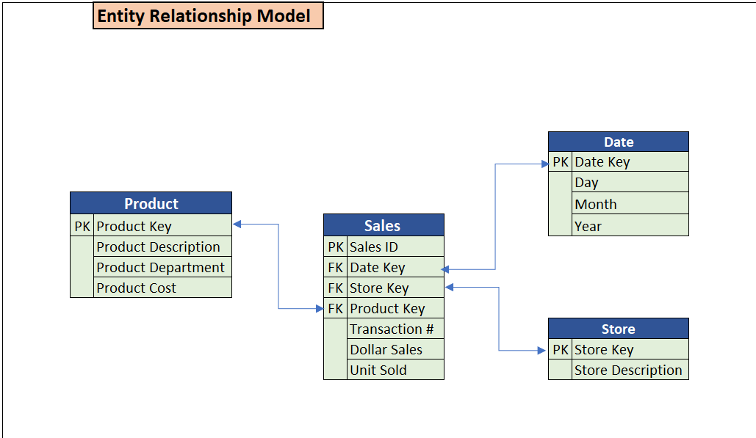
The Sales table has foreign keys (FK) that reference the primary keys (PK) of the Date, Store, and Product tables.
This establishes relationships between the Sales table and the Date, Store, and Product tables.
Dimensional model
This structure allows to track sales transactions along with associated dates, stores, and products, facilitating analysis and reporting.
Insights on each table are followed in the next slides…

Slide 5
Product table
Product Key | Product Description | Product Department | Product Cost
1 | Great Value White Bread | Bakery | $1.97
2 | Dempster's Original Bagels,Pack of 6 | Bakery | $3.77
3 | Ferrero Rocher | Snacks and Candy | $10.98
4 | Quaker Crispy Minis | Snacks and Candy | $2.97
5 | Bear Paws Chocolate Chip Cookies | Snacks and Candy | $3.27
6 | Sealtest Partly skimmed 2% milk | Dairy | $5.89
7 | Sealtest Homogenized 3.25% milk | Dairy | $6.89
8 | Great Value Cream Cheese | Dairy | $2.97
9 | Great Value XL White Eggs | Dairy | $4.48
10 | Cucumber Seedless | Fresh Produce | $1.77
11 | Cilantro | Fresh Produce | $1.27
12 | Banana | Fresh Produce | $0.40
13 | Onion Yellow | Fresh Produce | $2.97
14 | Carrots | Fresh Produce | $2.97
15 | Redpath Sugar | Pantry Food | $2.97
16 | Nuttela Hazelnut Spread | Pantry Food | $6.97
17 | Kraft Cream Ceasar Dressing | Pantry Food | $3.77
18 | Dempsters Original Large Tortillas | International Foods | $4.77
19 | Brar's Ghee | International Foods | $28.57
20 | Great Value Gingerbread training kit | Bakery | $12.00
21 | Furlani Garlic Bread | Bakery | $2.47
22 | Great Value Hot Dog Buns | Bakery | $2.87
23 | Balderson Medium Cheddar | Deli | $9.37
24 | Fresh Market Forest Ham | Deli | $3.47
25 | Hummus | Deli | $3.47
26 | Butterball Turkey bone-in-breast | Meat | $14.38
27 | Deli Express Bacon | Meat | $6.97
28 | Original Pork breakfast Sausage | Meat | $4.97
29 | Minute Maid Peach Punch | Frozen Food | $1.67
30 | Great Value Butter Puff Pastry | Frozen Food | $3.97
31 | Magnum Double Caramel Ice cream Bar | Frozen Food | $6.27
32 | Great Value Extra Fine Whole Beans | Frozen Food | $2.57
33 | Eggo original waffles | Frozen Food | $6.97
34 | Great Value Frozen Mixed Vegetables | Frozen Food | $2.57
35 | Sealtest Eggnog | Dairy | $2.97
36 | Gay Lea Sour Cream | Dairy | $2.98
37 | Sealtest 10% Half and Half Coffee Cream | Dairy | $3.98
38 | Great Value Salted Butter | Dairy | $6.48
39 | Silk Almond Beverage | Dairy | $4.47
40 | Lettuce | Fresh Produce | $3.97
41 | Basil | Fresh Produce | $1.97
42 | Blueberries | Fresh Produce | $4.97
43 | Dill, 1 Bunch | Fresh Produce | $2.47
44 | Starfrit Fry Pan | Cookwear | $11.97
45 | Jovati Kitchen Rapid Stainless Steel Water Kettle | Cookwear | $5.40
46 | Starbasix Egg Poacher with 4 cups | Cookwear | $24.97
47 | Granite Ware 15 Inch Oval Roaster w/Lid | Cookwear | $36.03
48 | Basic Fitted Sheet | Bedding | $15.37
49 | Mainstays Fitted Sheet | Bedding | $11.47
50 | Mainstays Comfort Pillow | Bedding | $4.47
Product Key: Primary key for the Product table.
Product Description: Full Product name.
Product Department: The department to which the product belongs (e.g. Produce, Frozen, Grocery).
Product Cost: Cost associated with the product in dollars.

Slide 6
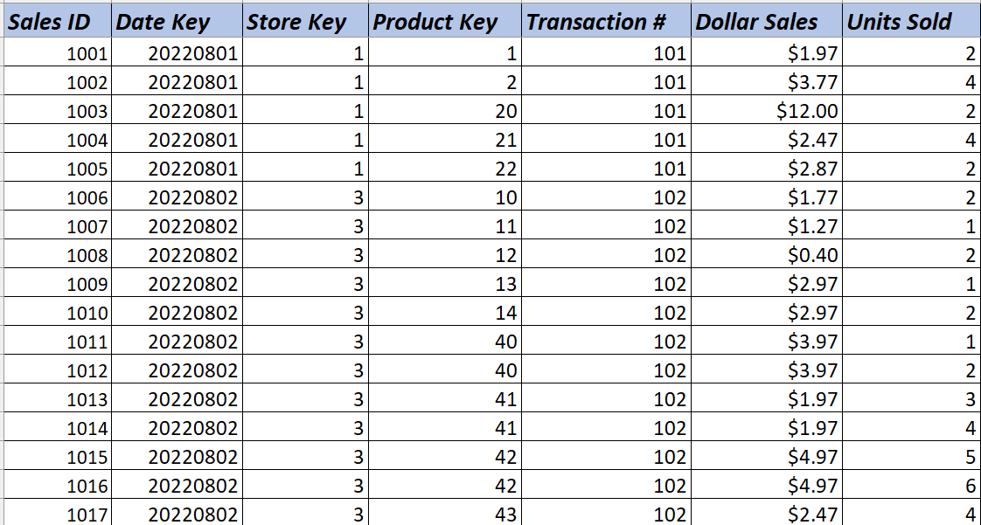
Sales ID: Primary key for the Sales table.
Date Key: Foreign key referencing the Date table.
Store Key: Foreign key referencing the Store table.
Product Key: Foreign key referencing the Product table.
Transaction #: Transaction number associated with the sale.
Dollar Sales The total dollar amount of the sale.
Unit Sold: The number of units sold in the transaction.
Total Rows are 100 in the draft version, projecting a total of 500 rows for Final submission.
sales table

Slide 7
stores table
Store Key | Store Description
1 | Wallmart
2 | Food Basics
3 | Freshco
Store Key Primary key for the Store table.
Store Description: Store name
Date Key | Day | Month | Year
20220801 | 1 | 8 | 2022
20220802 | 2 | 8 | 2022
20220903 | 3 | 9 | 2022
20220904 | 4 | 9 | 2022
20220905 | 5 | 9 | 2022
20221006 | 6 | 10 | 2022
20221007 | 7 | 10 | 2022
20221008 | 8 | 10 | 2022
20221109 | 9 | 11 | 2022
20221109 | 10 | 11 | 2022
20221211 | 11 | 12 | 2022
20221212 | 12 | 12 | 2022
20220813 | 13 | 8 | 2022
20230114 | 14 | 1 | 2023
20230115 | 15 | 1 | 2023
20230116 | 16 | 1 | 2023
20230217 | 17 | 2 | 2023
20230318 | 18 | 3 | 2023
20230419 | 19 | 4 | 2023
20230520 | 20 | 5 | 2023
20230521 | 21 | 5 | 2023
20230522 | 22 | 5 | 2023
20230523 | 23 | 5 | 2023
20230524 | 24 | 5 | 2023
20230625 | 25 | 6 | 2023
20230626 | 26 | 6 | 2023
20230627 | 27 | 6 | 2023
20230628 | 28 | 6 | 2023
20230629 | 29 | 6 | 2023
20230630 | 30 | 6 | 2023
20230601 | 1 | 6 | 2023
20230702 | 2 | 7 | 2023
20230903 | 3 | 9 | 2023
20231004 | 4 | 10 | 2023
20231105 | 5 | 11 | 2023
20231106 | 6 | 11 | 2023
20231107 | 7 | 11 | 2023
20231108 | 9 | 11 | 2023
20231109 | 10 | 11 | 2023
20231110 | 11 | 11 | 2023
20231111 | 12 | 11 | 2023
20231112 | 13 | 11 | 2023
20231113 | 14 | 11 | 2023
20231114 | 15 | 11 | 2023
20231115 | 16 | 11 | 2023
20231116 | 17 | 11 | 2023
20231117 | 18 | 11 | 2023
20231118 | 19 | 11 | 2023
20231020 | 20 | 10 | 2023
20231121 | 21 | 11 | 2023
Date table
Date Key: Primary key for the Date table.
Day: Day of the date.
Month: Month of the date.
Year: Year of the date.

Slide 8
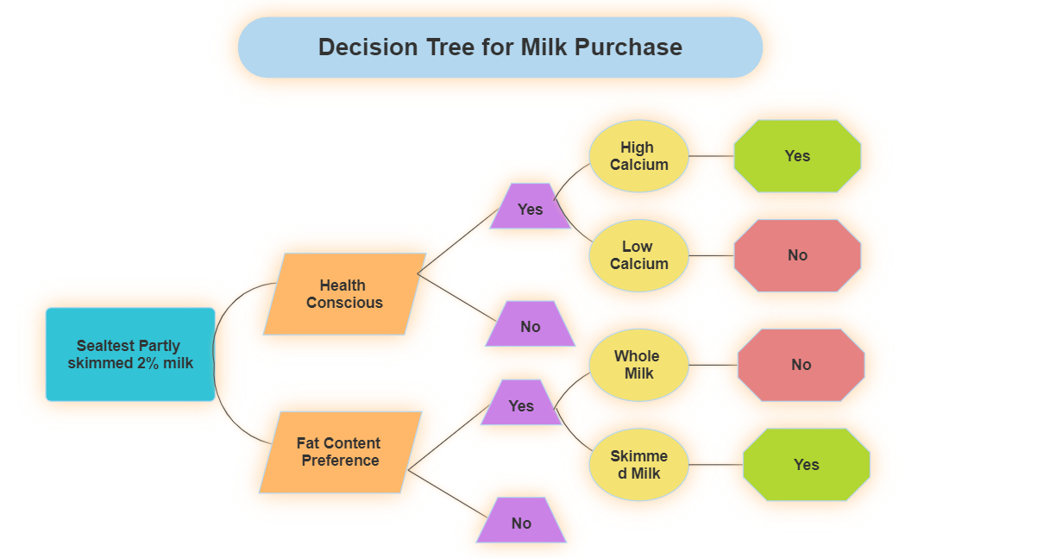
classification model
The model is targeted on the Sealtest Partly skimmed 2% milk
The We have 2 levels of decision filtering.
Health conscious or Fat Content preference
2.1 High Calcium / Low Calcium
2.2 Whole Milk / Skimmed Milk

Slide 9
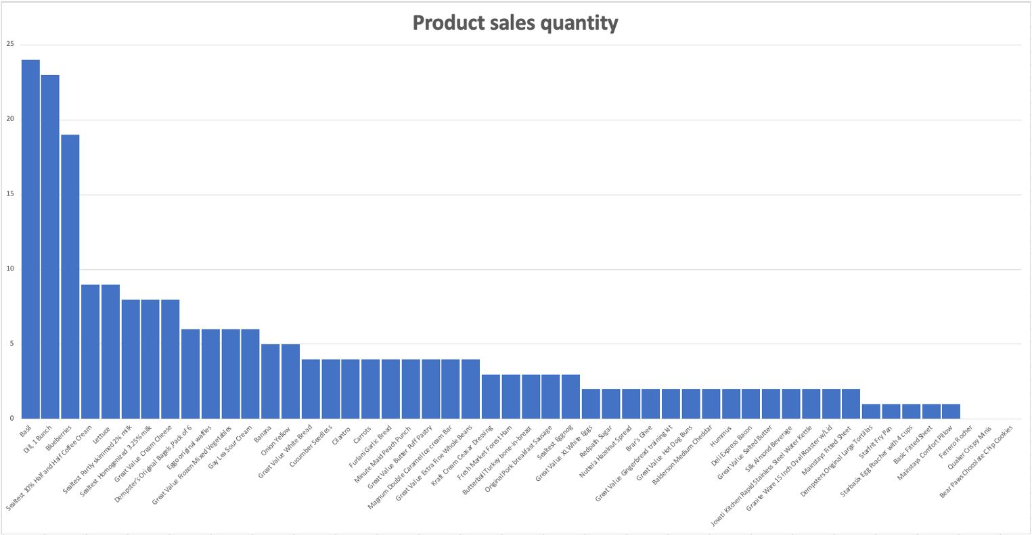
Text model
The graph is plotted on groceries dataset by counts the frequency of the product
One of the insight from this graph are the Top-Selling Products:
Can easily identify the highest frequencies on the graph. These are likely your top-selling products. In our dataset it is Basil.

Slide 10
Summary
Text Model - Frequency Graph:
Objective: Analyze term frequencies in text by counting the products.
Insights: Highest purchased item or Least preferred item.
Entity-Relationship Diagram (ERD):
Objective: Visualize database relationships.
Insights: Understand database structure.
Decision Tree:
Objective: Build a classification model.
Insights: Understand factors influencing decisions.
Key Takeaways:
Uncover product patterns with frequency graphs.
We can make informed decisions with a classification model.
Visualized database relationships.

Slide 11
Any questions?

